Slide 1
Approximation Algorithms: Traveling Salesperson
Session 24
Henry Lucky, S.Kom. M.Kom.

Slide 2
Outline Materials
Session 24
The traveling sales-person problem
Triangle inequality
The general traveling sales-person problem

Slide 3
Learning outcomes
24
LO 1: Explain fundamental concept of analysis algorithms
LO 2: Apply algorithm techniques and methods
LO 3: Solve a problem using specific algorithm.
LO 4: Compare several algorithm design methods

Slide 4

The traveling sales-person problem
Formal definition
Given:
A complete undirected graph $G = (V, E)$that has nonnegative integer cost $c(u, v)$associated with each edge $(u, v)∈E$.
Objective:
Find a Hamiltonian cycle (a tour) of G with the minimum cost.
Let $c(A)$denote the total cost of the edges in the subset $A⊆E$:
$$c\left(A\right)=\sum_{(u, v)∈A}{c(u, v)}$$

Slide 5

The traveling sales-person problem
Formal definition
The least costly way to go from a place u to place w is to go directly, with no intermediate steps.
Cutting out an intermediate stop never increases the cost.
Such cost function $c$ satisfies the triangle inequality: for all vertices $u, v, w ∈V ,$
$$c\left(u, w\right)≤c\left(u, v\right)+c(v, w)$$
The triangle inequality seems as though it should naturally hold, and it is automatically satisfied in several applications.
Many cost functions including Euclidean distance satisfy the triangle inequality.

Slide 6
The traveling sales-person problem
Solving strategy
Due to the complexity of the TSP, several heuristic and approximation algorithms have been developed to find near-optimal solutions efficiently. Some popular algorithms include:
Nearest Neighbor Algorithm: This simple greedy algorithm starts from a randomly chosen city and repeatedly selects the nearest unvisited city until all cities are visited. The final tour may not be the shortest, but it provides a decent approximation.
Genetic Algorithms: Inspired by biological evolution, genetic algorithms use techniques like mutation, crossover, and selection to iteratively improve a population of tours until a satisfactory solution is found.
Ant Colony Optimization: Inspired by the foraging behavior of ants, this algorithm employs pheromone-based communication to guide the search for shorter paths. It simulates a population of artificial ants to explore the solution space efficiently.
Simulated Annealing: This metaheuristic algorithm is inspired by the annealing process in metallurgy. It allows the algorithm to escape local optima by probabilistically accepting worse solutions initially and gradually decreasing the acceptance probability.

Slide 7
Triangle inequality
The traveling-salesperson problem with the triangle inequality
How do we develop a 2-approximation algorithm for this problem?
Just like the previous session:
Compute the lower bound on the length of an optimal traveling-salesperson tour (we can use MST).
Create a tour (using the MST) whose cost is no more than twice that of the MST’s weight, as long as the cost function satisfies the triangle inequality.
The procedure APPROX-TSP-TOUR on the next page implements this approach, calling the MST-PRIM.
The parameter G is a complete undirected graph, and the cost function c satisfies the triangle inequality.

Slide 8
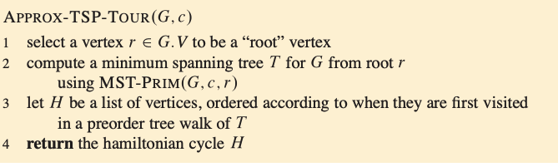
Triangle inequality
MST Algorithm
Notes:
a preorder tree walk recursively visits every vertex in the tree, listing a vertex when it is first encountered, before visiting any of its children.

Slide 9
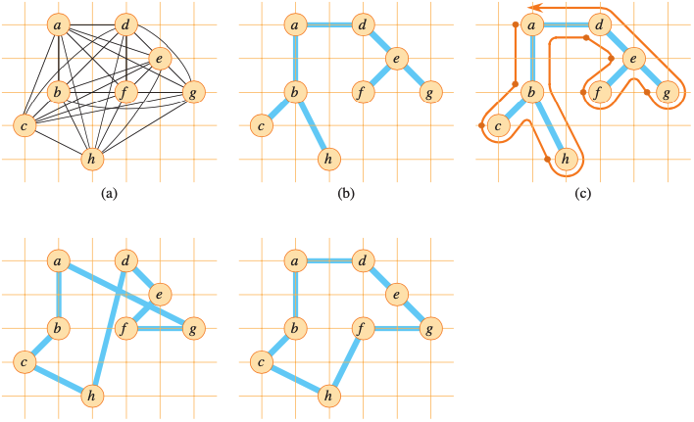
Triangle inequality
MST Algorithm
A complete undirected graph

Slide 10
Triangle inequality
MST Algorithm
A minimum spanning tree T of the complete graph, as computed by MST-PRIM. Vertex a is the root vertex.

Slide 11
Triangle inequality
MST Algorithm
A walk of T, starting at a.

Slide 12
Triangle inequality
MST Algorithm
A tour obtained by visiting the vertices in the order given by the preorder walk, which is the tour H returned by APPROX-TSP-TOUR. Total cost is approx. 19.074

Slide 13
Triangle inequality
MST Algorithm
For comparison, this is the optimal tour H* for the original complete graph. Total cost is approx. 14.715

Slide 14

Triangle inequality
MST Algorithm
The running time of APPROX-TSP-TOUR is $Θ(V^{2})$ even with simple implementation of MST-PRIM (Using adjacency matrix).
Despite the small approximation ratio, APPROX-TSP-TOUR is usually not the best practical choice for this problem.

Slide 15

Triangle inequality
Other Algorithms
There are other approximation algorithms that perform much better, such as Christofides’ Algorithm which gives 1.5-approximation ratio.
The Christofides’ algorithm still stands as the best polynomial time approximation algorithm that has been thoroughly peer-reviewed by the relevant scientific community for the traveling salesman problem.
In July 2020 however, Karlin, Klein, and Gharan released a preprint in which they introduced a novel approximation algorithm and claimed that its approximation ratio is 1.5 − ${10}^{−36}$. It follows similar principles to Christofides’, but incorporates Randomized Algorithm.

Slide 16

The general traveling-salesperson problem
When the cost function c does not satisfy the triangle inequality, there is no way to find good approximate tours in polynomial time unless P = NP.
If P $≠$ NP, then for any constant $ρ≥1$, there is no polynomial-time approximation algorithm with approximation ratio $ρ$ for the general traveling-salesperson problem.

Slide 17
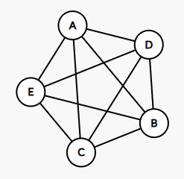
exercise
Imagine you are a salesperson traveling to multiple cities to meet clients, and you want to find the shortest possible route to visit each city exactly once and return to your starting point. Let's consider the following cities and their pairwise distances (in kilometers). Cities: A, B, C, D, E
Distances:
A to B: 10 km
A to C: 15 km
A to D: 20 km
A to E: 25 km
B to C: 12 km
B to D: 18 km
B to E: 22 km
C to D: 14 km
C to E: 8 km
D to E: 16 km
Find an approximate solution to the Traveling Salesperson Problem (TSP) starting from City A.

Slide 18
References
Thomas H. Cormen. (2022). Introduction to algorithms: Fourth edition. The MIT Press. Chapter 35.

Slide 19
Thank you
Approximation Algorithms: Traveling Salesperson
September, 2023

